Slide 1
JAVA PROJECT QUIZ MANAGEMENT SYSTEM
SUBMITTED BY : SUBMITTED TO:
AKASH KUMAR(191210007) Dr. SEEMA KHARB
ARUSHI JAISWAL(191210013)
NEHAL SARAN(191210033)

Slide 2
TABLE OF CONTENTS:
NEED OF SYSTEM
OBJECTIVE
SOFTWARE REQUIREMENTS
FLOW DIAGRAM
FUNTIONAL AND NON FUNCTIONAL REQUIREMENTS
CONNECTIVITY
ADMIN DETAILS
STUDENT DETAILS

Slide 3
NEED
With the upheaval in technology, everything today is being conducted online and in situations like the pandemic it becomes necessary to conduct all the quizzes online for efficient conduction of the assessment with fair grading.
Also it offers us a lot of advantages as it works according to the instructions given to the system and helps to evaluate the test takers freely and cost-effectively through computer-based tests.

Slide 4
OBJECTIVE:
Taking Quiz is a very important part of education and content revising. With the help of “Online Quiz Management System”, we intend to make an efficient system where users would be able to create and conduct quizzes for students and also ensures fair conduction of the assessments
. Online quiz management system can be implemented in colleges, universities or at home to check the preparation of students and revise contents of different courses.
It provides a common platform to connect the students and teacher and helps in the efficient management and fair assessment of quiz through an online platform. The registered teachers can create Quiz and student can take quiz and can asses himself/herself.

Slide 5
SOFTWARE REQUIREMENTS:
SOFTWARE USED: Netbeans IDE
DRIVER: JDBC for connectivity
LANGUAGE USED:JAVA
DATABASE:MYSQL

Slide 6
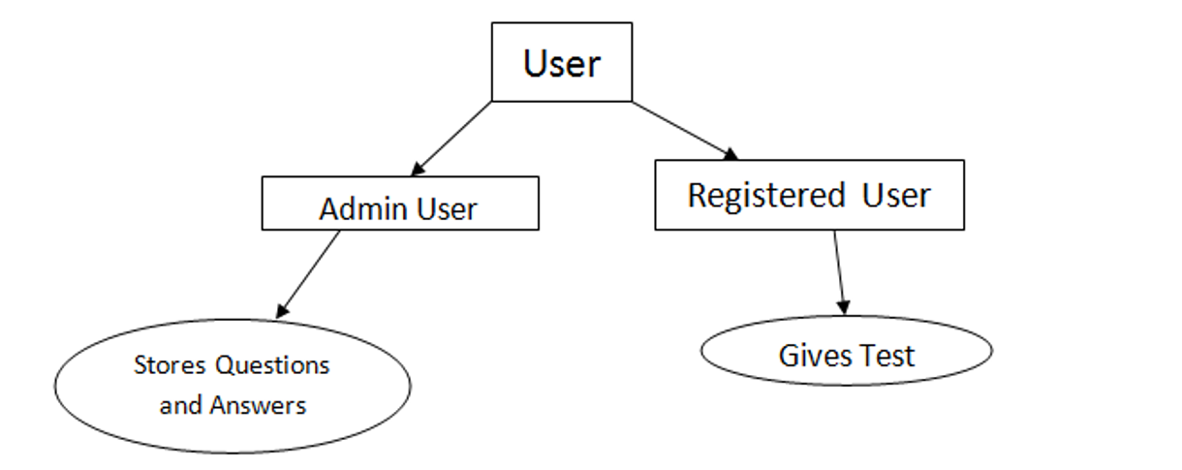
FLOW DIAGRAM

Slide 7
FUNCTIONAL REQUIREMENTS:
ADMIN:
Add new question.
Update question.
They Can view all question currently in the databse.
They can view all student result.
The admin should be registered i.e. they should have a login id and password details.
The admin can delete the questions
The admin can see all student details.

Slide 8
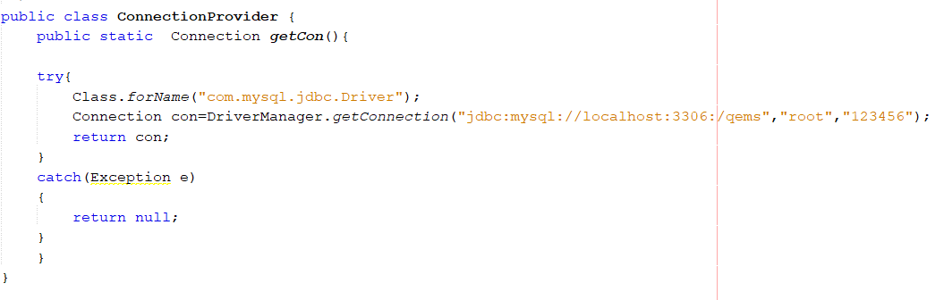
CONNECTIVITY:
THROUGH JDBC-connector:

Slide 9
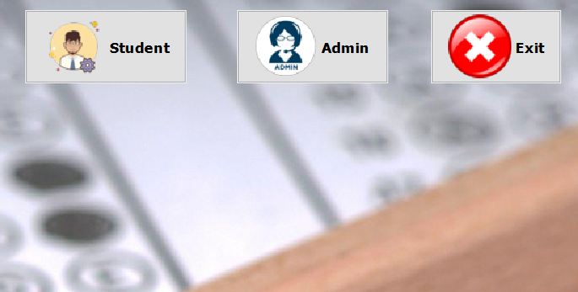
There are two modules: student admin

Slide 10
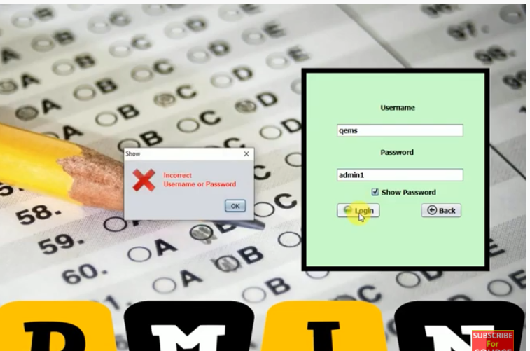
LOGIN PAGE
In loginpage username and password are two labels which has the corresponding text fields and password field. There is a checkbox which is used to show the password. Entering wrong user name or password will display a pop up message
There is A Back Button which will take you back to the Main page. If you enter the Correct Username and password You will go to the next page which admin page.

Slide 11
ADMIN MODULE

Slide 12
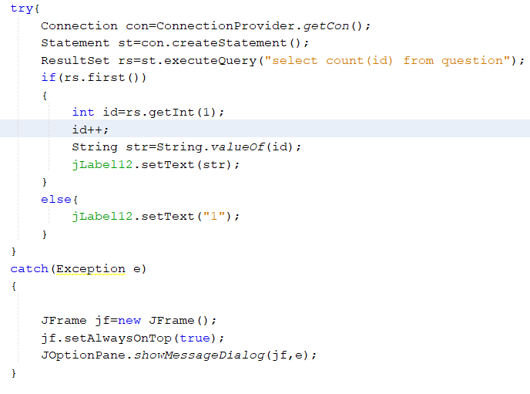
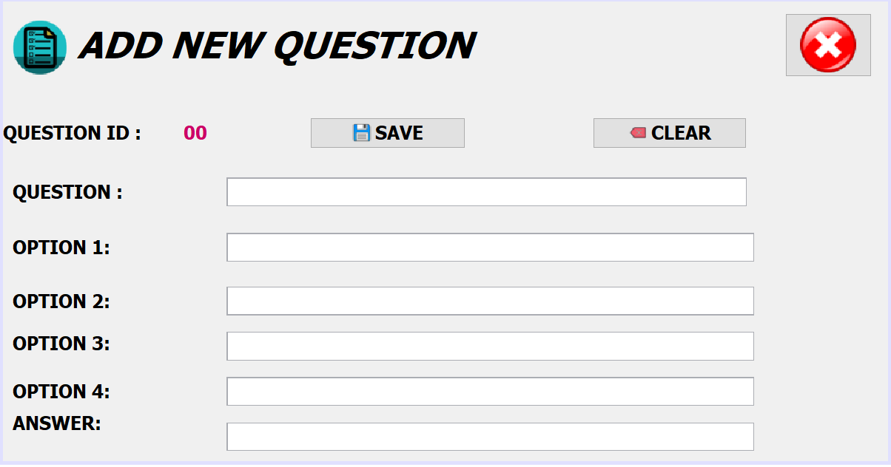
ADD NEW QUESTION:
To add a new question we use the different text fields and fetch the table ‘questions’ from the database from which we use the aggregate function COUNT to get the total number of questions and hence set the auto increment feature of question id if the total number of questions is not null.

Slide 13
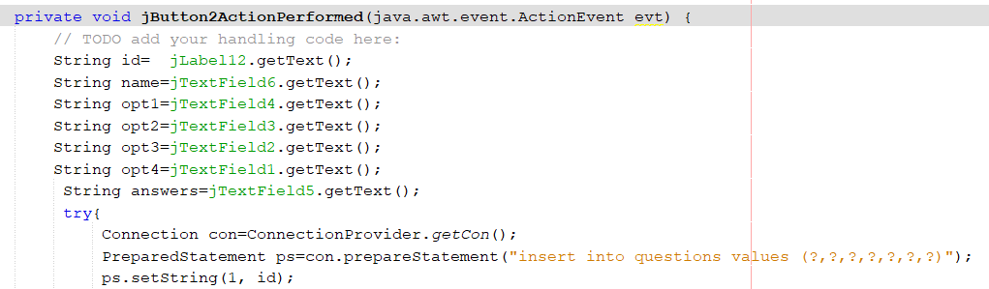
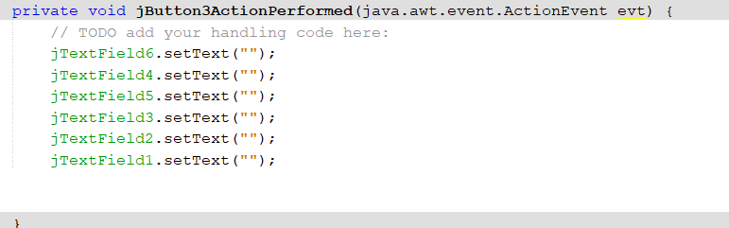
SAVE OPTION:
Then by using the getText method we store all the options in different strings and insert it into the database by executing the query.
And after updating it returns the result by displaying the message”successfully updated”.
CLEAR OPTION:
We use the setText method to set all the values in textfields to null;

Slide 14
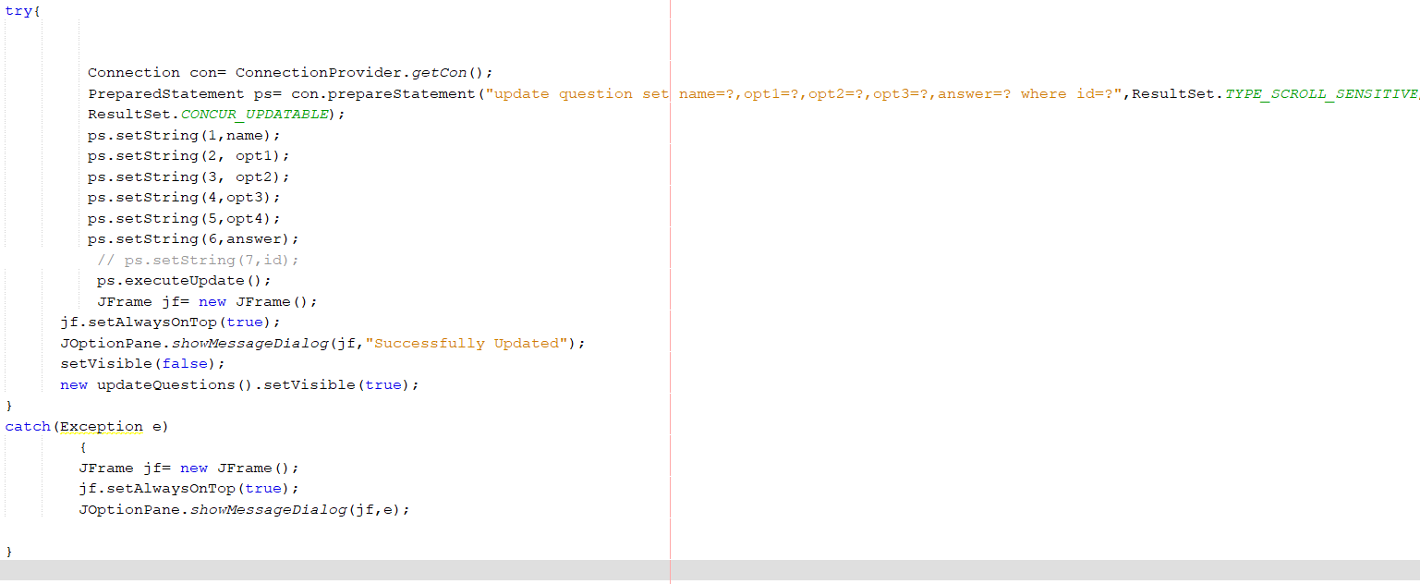
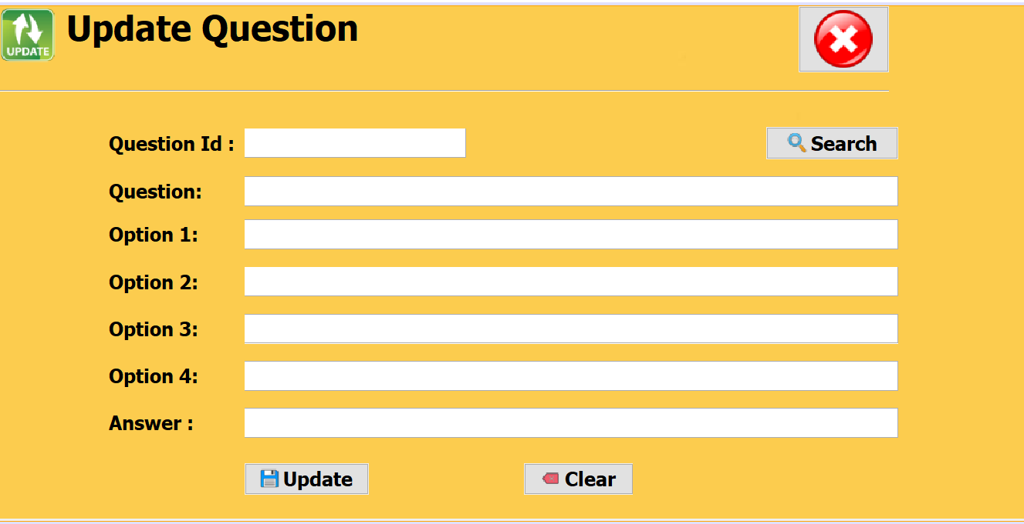
UPDATE QUESTION:
The question can be searched from the database with the help of ‘id’ and then can be modified. The question will be searched through question id by fetching the tuple from ‘questions’.

Slide 15
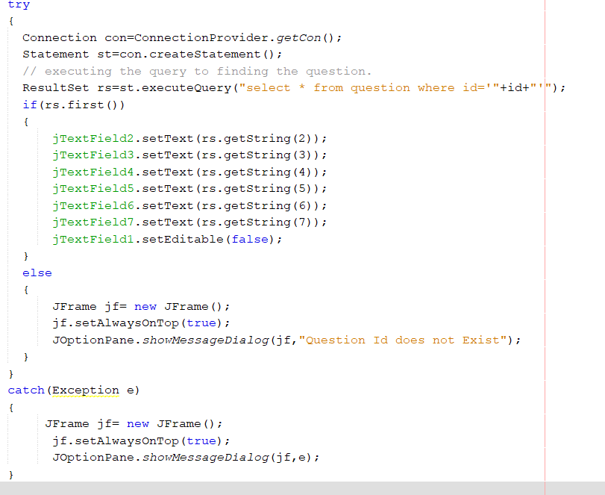
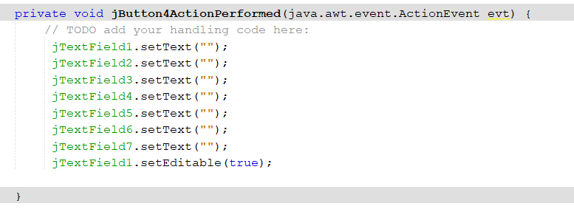
Search option :
The question is searched through id and function used is getText().
Update option :
The update option made the changes saved in the database .The function used is setText().
Clear option :
The option sets all the textfields to null.

Slide 16
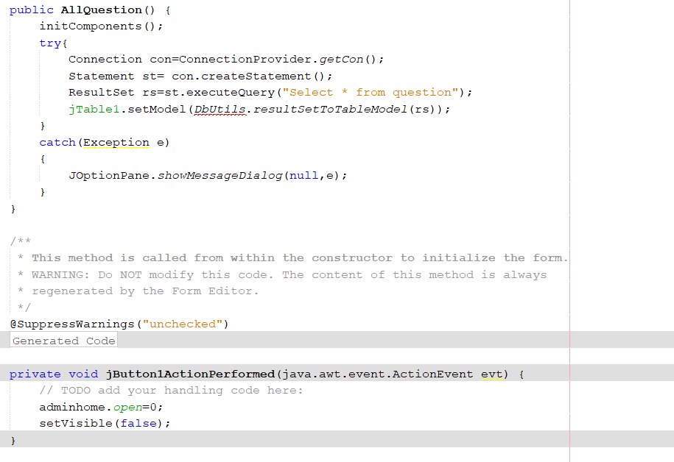
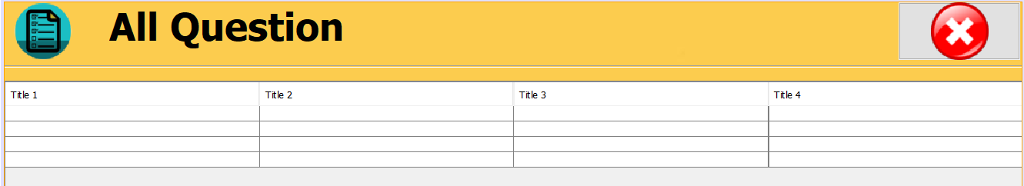
ALL QUESTIONS:
This window display all the question which has been added to the database.

Slide 17
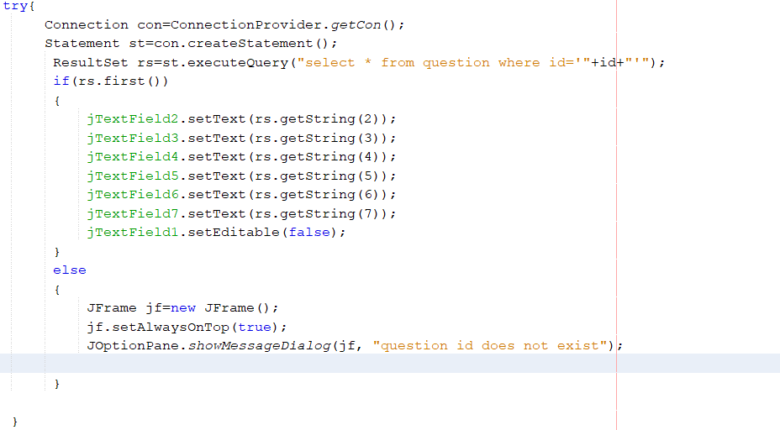
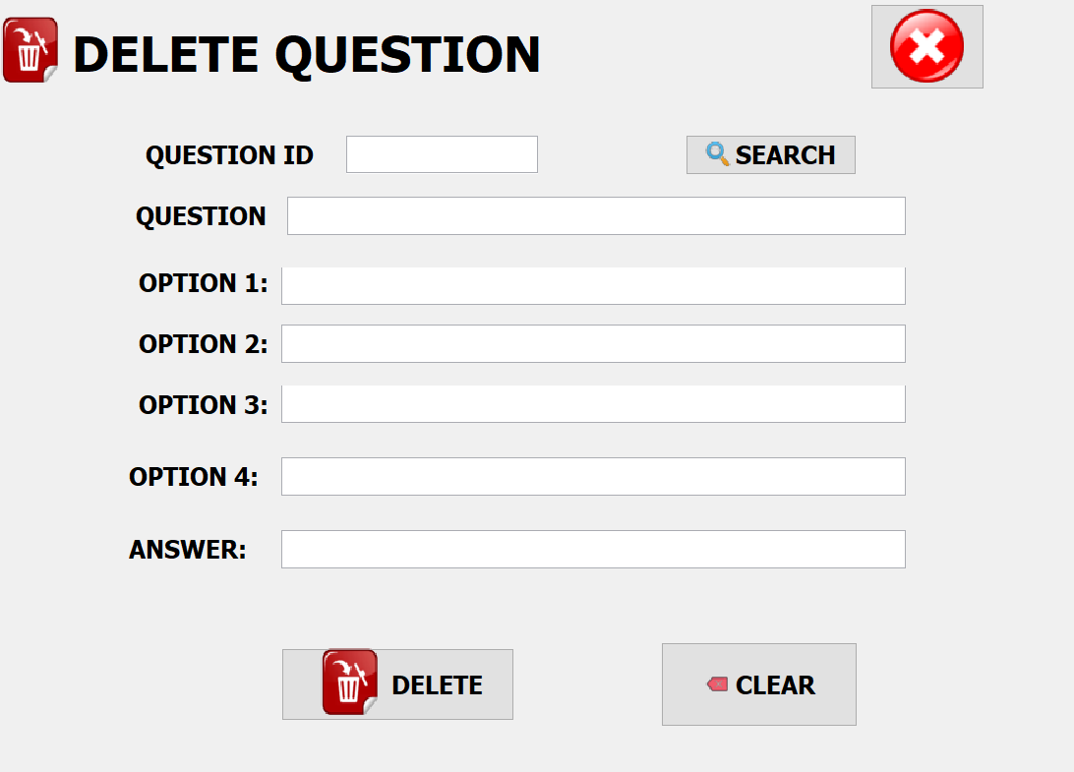
DELETE QUESTIONS
If there is unnecessary question added to the database then it is deleted through this window. The question to be deleted is searched through question id.

Slide 18
STUDENT MODULE

Slide 19
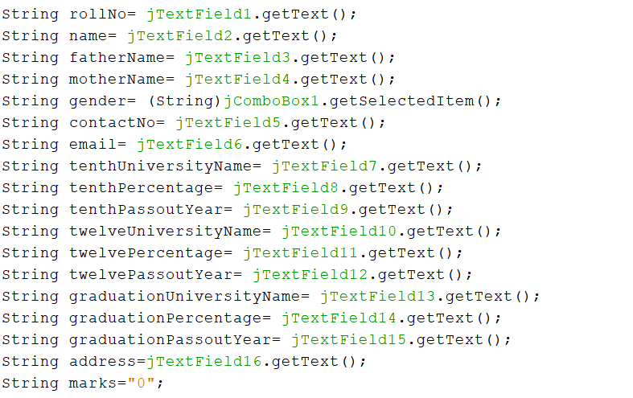
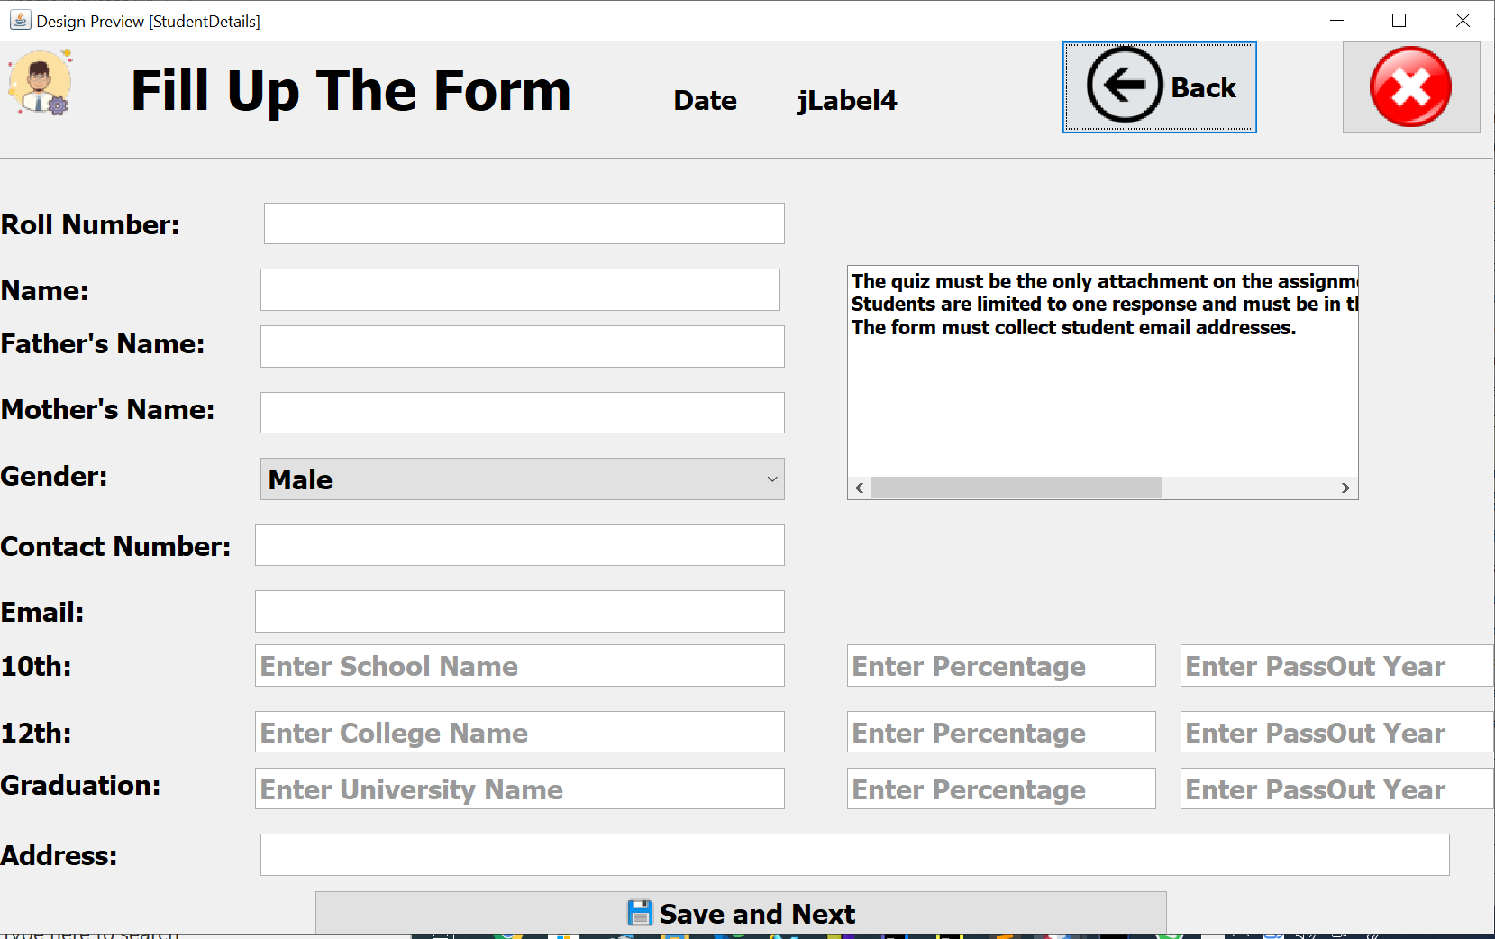
STUDENT FILL UP FORM
This window is for the student section. Basically a form In which after filling all the details it will add the corresponding student details to our student database. We can fetch the details of the any student.

Slide 20
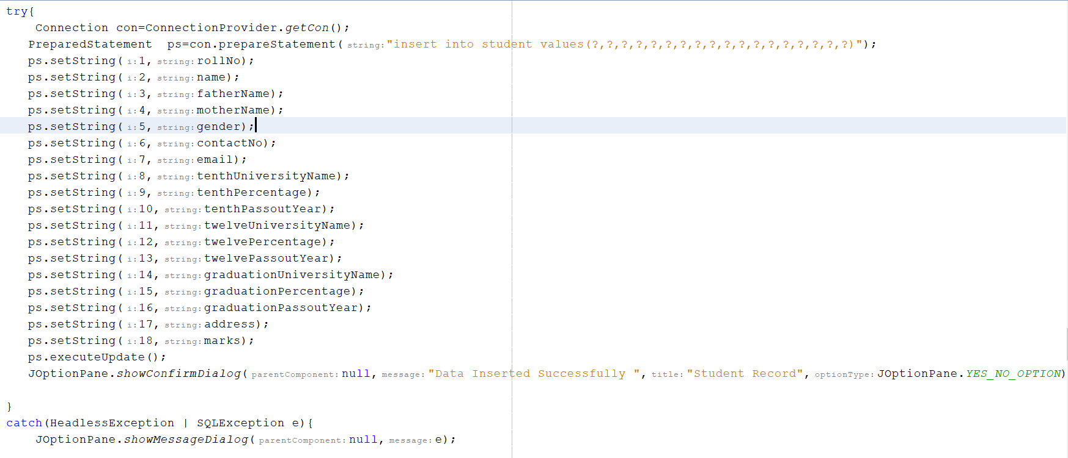
SAVE AND NEXT save and next button will execute the query "insert into student values(?,?,?,?,?,?,?,?,?,?,?,?,?,?,?,?,?,?)" and add it to our student database;

Slide 21
THANK YOU

